Slide 1

Incident Liability Fee Implementation Strategy & Vehicle Profitability Analysis

Slide 2
2018 Stats
Total Revenue : $64,866,040.00
Total Costs 2018 : $33,076,688.64
Total Profit 2018 : $31,789,351.36
# of Transactions : 100,000
Total # of Driving Incidents : 4,940

Slide 3
Paying more in costs than receiving in profit.
Total Costs 2018 : $33,076,688.64
Total Profit 2018 : $31,789,351.36
Paying $1,287,337.28 more than we’re receiving.
Total # of Driving Incidents : 4,940
How can we optimize our business model to have more profitability?

Slide 4
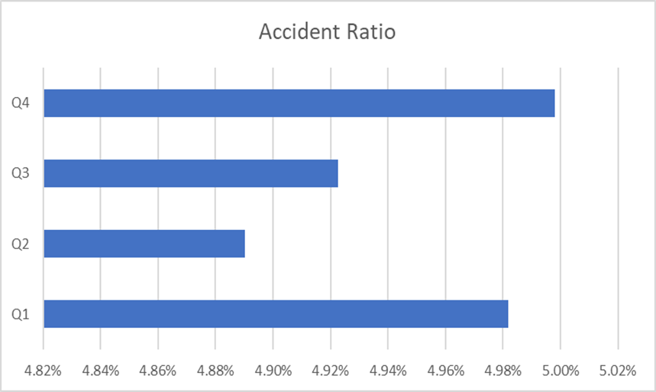
Strategy 1 – Seasonal Liability Fee
Goal: Implement a $30 "Seasonal Liability Fee" to transactions in the two financial quarters with higher risk of driver incidents.
These financial quarters can be easily identifiable as Q4/Q1.
The avg. accident ratio for 2018 was 4.95%

Slide 5
Strategy 1- Continued…
By implementing a $30 seasonal liability fee in Q1/Q4, not only can we give a healthy reminder to clientele to drive safely during our more hazardous financial quarters, we can forecast and additional $1,249,440.00 in net revenue for the next calendar year.
In the leave behind excel document, you can enter in additional values to compare against the $30 model.

Slide 6
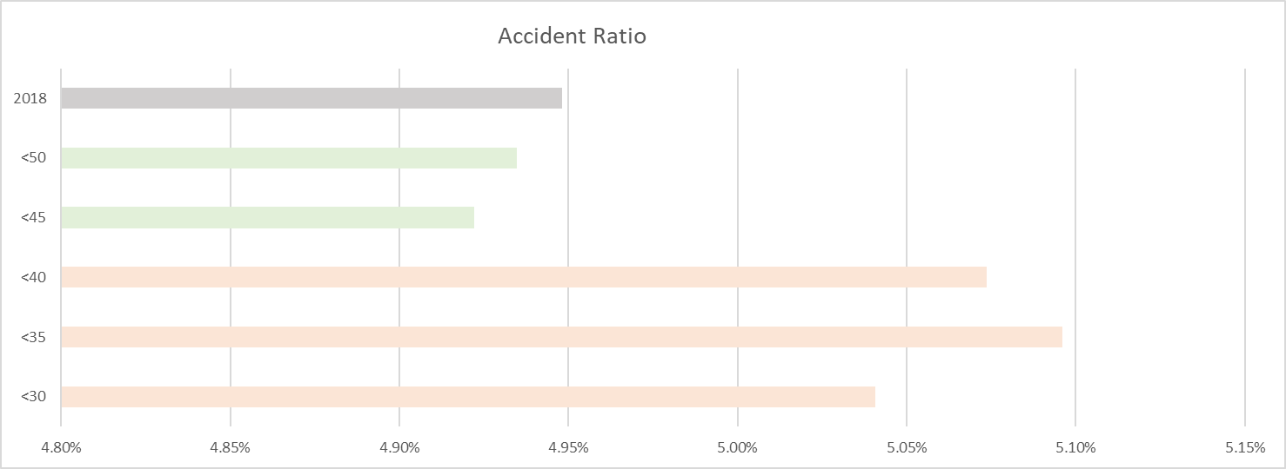
Strategy 2- Mature Driver Discount
In the leave behind excel document, you can enter different percentages to compare against this model.
The Avg Accident Ratio for 2018 is 4.95%
Drivers who are under the age of 40, tend to be more prone to get into car accidents. This results in more expensive insurance policies, and higher costs for LARIAT RENT-A-CAR.

Slide 7
Strategy 2- Continued…
Implement a 5% price increase to drivers under the age of 40. Do this by a flat 5% price increase and implementing a 5% Mature Driver discount to drivers 40 and up.
We can phrase the price increase with positive verbiage, by doing so we can also account for a 3% increase to transactions with drivers ages 40+.
Result: By combining the increased revenue from both effects, we can project $2,422,692.58 in net revenue.

Slide 8
Selecting the right vehicles to invest in
Which vehicles in our fleet have the most profitability?
Let’s analyze these three variables:
Profit per day
# of transactions for 2018
Total profit for 2018.

Slide 9
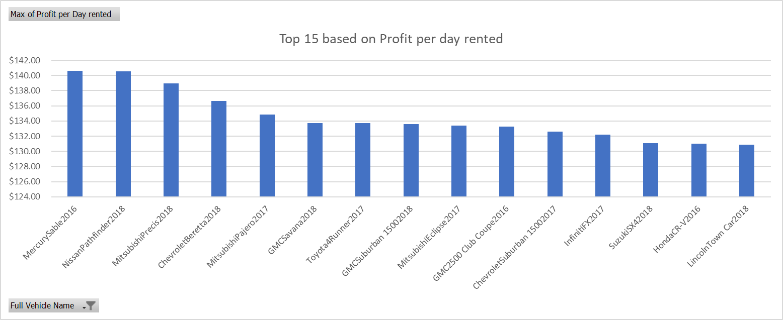
Top 15 – Profit per day rented.
These are the top 15 most profitable per day they were rented!
Items highlighted in green fall in the top 15 for each category.
Items highlighted in yellow fall in two of the three.
Items with red only fall in one.

Slide 10
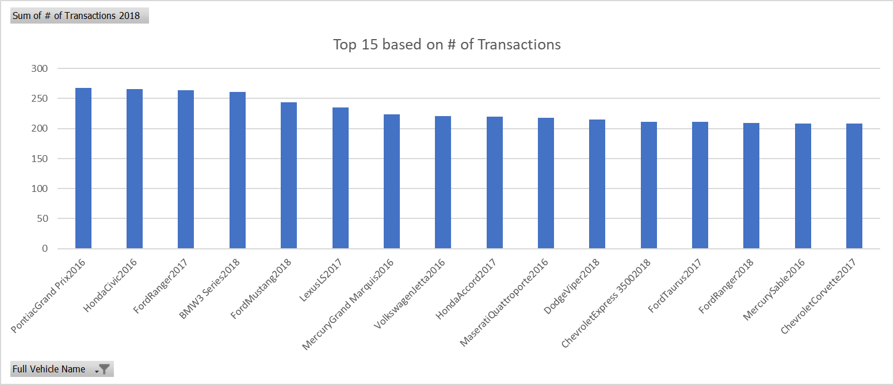
Top 15 - # of transactions
These are the vehicle in most demand for 2018!

Slide 11
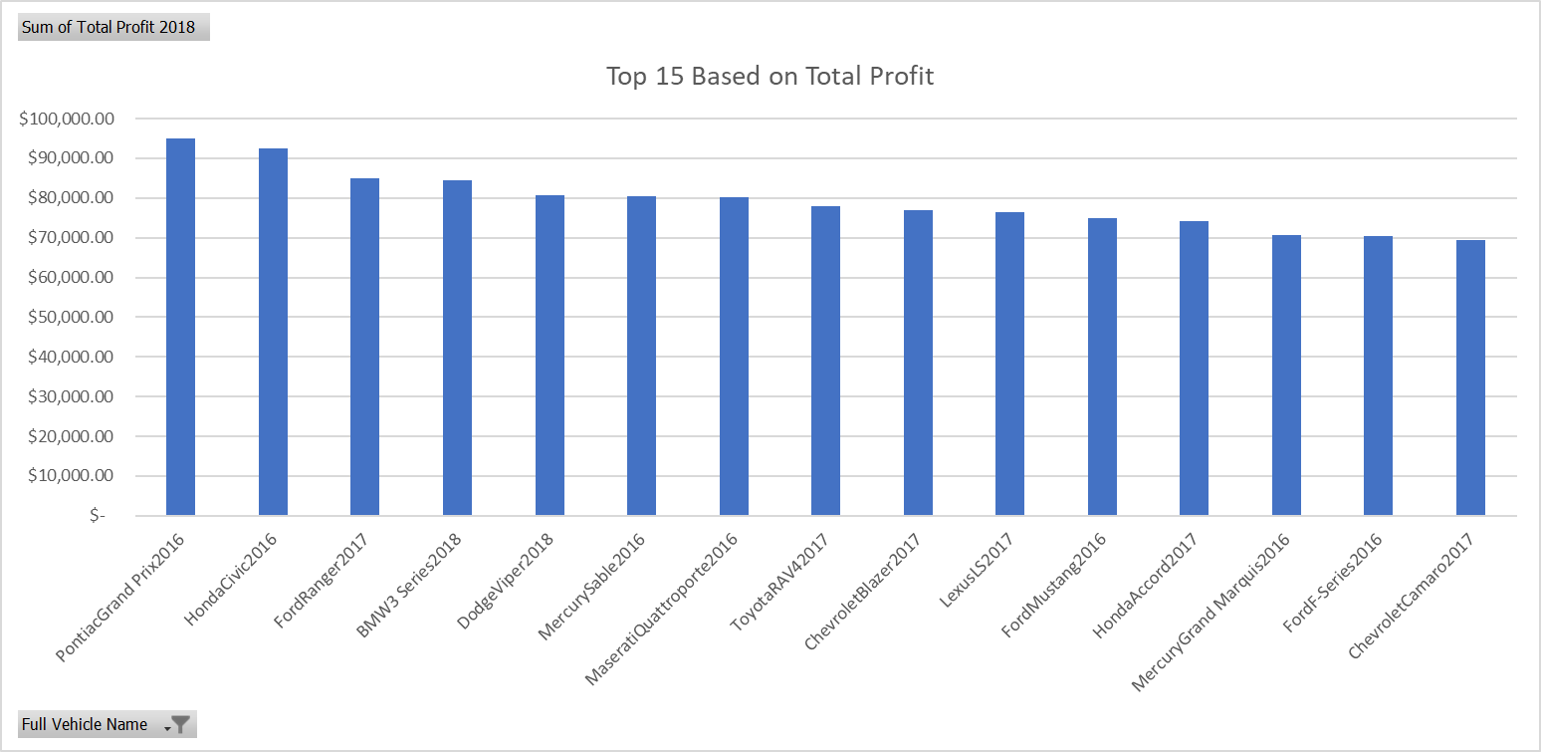
Top 15 – Total Profit
These 15 vehicles generated the most profit for LARIAT in 2018

Slide 12
Vehicle Investment Suggestions
Result: The only vehicle that Is consistently in the top 15 for each category is the Mercury Sable 2016.
Other vehicles which would be strong investments, due to their overall profit and demand, are as followed:
PontiacGrand Prix2016
LexusLS2017
DodgeViper2018
HondaCivic2016
MercuryGrand Marquis2016
MaseratiQuattroporte2016
FordRanger2017
HondaAccord2017
BMW3 Series2018

Slide 13
By Implementing a “Seasonal Liability” fee,
Increasing prices by 5%, and implementing a 5% Mature Driving discount,
And selecting the vehicles with the most profitability
We can optimize our business model to reduce losses caused by driver incidents and increase profitability for the company.
By doing this, we can reach our combined goal result, increasing net revenue by approx. $3,672,132.58.

